Slide 1
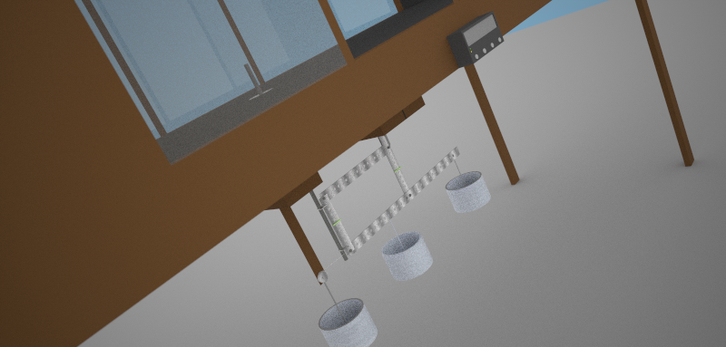




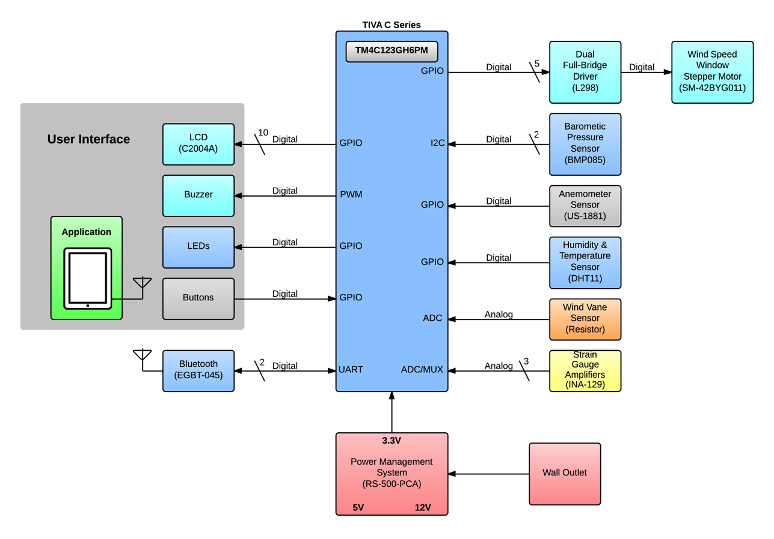

Team Members:
Description
The wind tunnel of the Department of the Civil Engineering at UPRM is used to measure aerodynamic forces acting on objects. The tunnel uses a manually controlled balance to measure drag and lift forces which makes this tool and procedure imprecise and outdated. AeroBal brings the tunnel to the 21st century by automating the process using sensors, motors, LCD screens, and Bluetooth compatibility, running on a powerful TM4C ARM Cortex-M4 processor.
AeroBal uses strain gauge sensors to accurately detect the forces exerted by the wind current. An LCD screen functions as the primary interface for controlling the system and displaying data in real time, which allows users to easily see experimentation data. To add extra ease, users are able to connect through Bluetooth to the system using a mobile application which permits convenient control of the system and the ability to read the data from the comfort of their tablets. Pressure, barometric, humidity, and temperature sensors will be implemented to give more data to the user. All of these sensors should give users more productivity when conducting research using the tunnel.
Anthony Llanos
Juan Lebrón
Jesus Luzon
Jean Méndez

